Slide 1
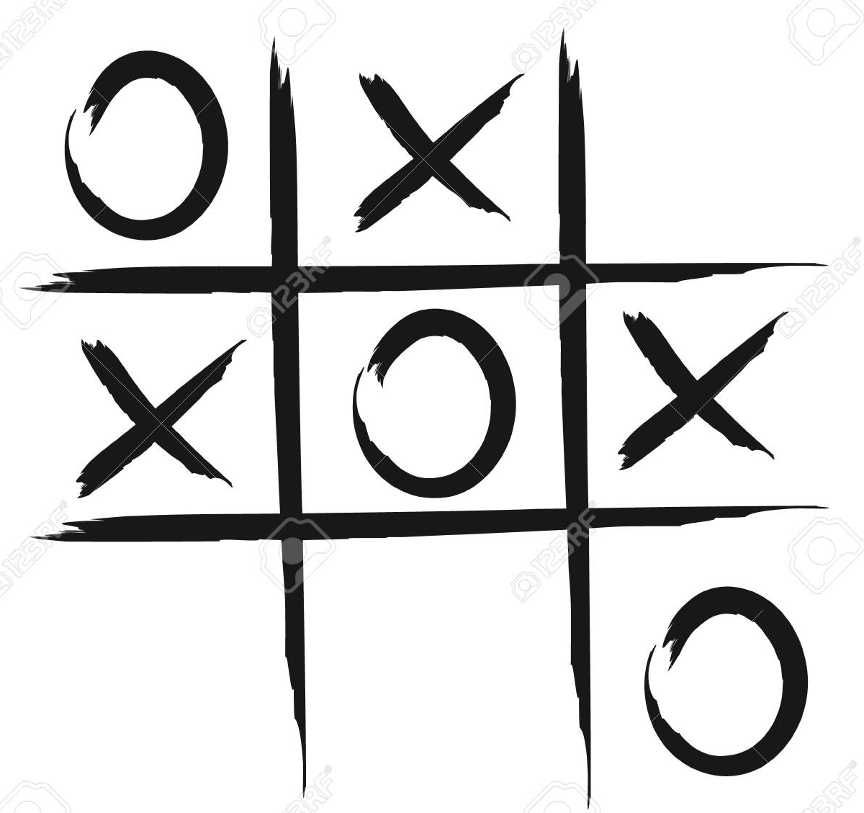
Minor Project I Game: Tic Tac Toe
Presented By:
Isha Mittal- 07
Sahil Verma- 15
Ramya Mihir- 11
Shubhangi Gupta- 18

Slide 2
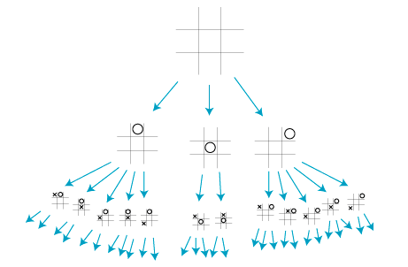
Introduction
Tic Tac Toe is a famously known game, which uses the Minimax Algorithm, so as to take the input from the user. This game is a two player game, where one player chooses cross (X) and the other player uses zero (0). In this game, each player seek an alternate turn to complete either a row, or a column or a diagonal with either three 0’s or three X’s that is drawn in the grid of nine squares.
Minimax algorithm which is used by this game, is a type of a backtracking algorithm that is used to make decisions and is also used in game theories to find the best optimal move for the player, supposing that the opponent player also plays optimally. This algorithm is widely used in the coding of games that posses only two players and not more than that.
The games that use this algorithm are: Tic-Tac-Toe, Chess, Manchala, etc.
Tic Tac Toe will be prepared using the C language, where the user will provide an input of X’s and O’s, then depending upon the inputs, the sytem will generate its empty spaces and if not, it will declare the result- tie/ winner, and the particular message will be displayed to the user.

Slide 3
Problem Statement
Constructing a Tic-Tac-Toe game having Minimax algorithm in C language.

Slide 4
Literature Review
There are two ways to solve the game
1.Brute-force Methods: Brute-force methods have been important tools helpful in solving games. Many solving programs use basic brute-force methods such as α-β and their enhancements in some way or another. Two methods which have their application especially in solving games are the construction of databases by retrograde analysis and enhanced transposition-table methods.
2. Knowledge-based Methods :-Next to brute-force methods it is often beneficial to incorporate knowledge-based methods in game-solving programs. Their main advantage is that it provides an appropriate move ordering or selection in the search trees.

Slide 5
Objectives
To create a GUI based tic tac toe game with the help of Minimax Algorithm using C language.
Sub Objectives
To provide an easy user interface to input X and Os.
User should be able to move across the screen
System should be able to preprocess the given input
System should detect text regions present in the image
System should retrieve text and display them to the user

Slide 6
Methodology
For this project, the technology being used is basic C language having Minimax Algorithm (backtracking algorithm) , wherein the player (user) inputs X and Os as per his/ her choice. The input is provided to the convolutional layer where the parameters are chosen, filters are applied with strides and padding is applied as well if required. The class generates an output using required output functions .
The entire implementation of this project can be summarized into the following steps:
1. Import the libraries and load the dataset
2. Preprocess the data
3. Create the model
4. Train the model
5. Evaluate the model
6. Testing the program

Slide 7
System Requirements
Hardware:
RAM: 4GB
Disk Space: 4GB
Software:
Dev C++ or any online compiler using C language
Operating System:
Windows 7,8,10,XP

Slide 8
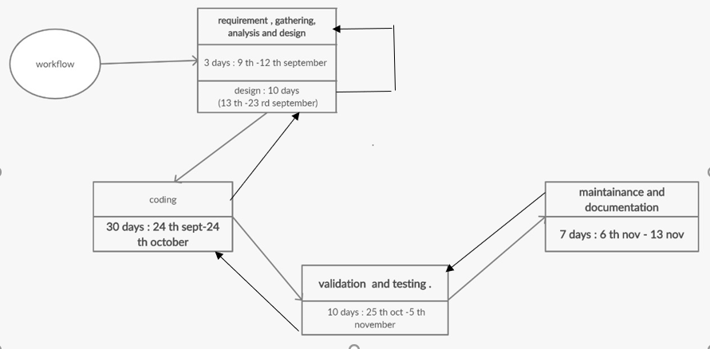
Schedule

Slide 9
Algorithm
Step-1: In the first step, the algorithm generates the entire game-tree and apply the
utility function to get the utility values for the terminal states.
Step 2: Now, first we find the utilities value for the Maximizer, its initial value is -∞, so
we will compare each value in terminal state with initial value of Maximizer and
determines the higher nodes values.
Step 3: In the next step, it’s a turn for minimizer, so it will compare all nodes value with
+∞, and will find the 3rd layer node values.
Step 4: Now it’s a turn for Maximizer, and it will again choose the maximum of all nodes
value and find the maximum value for the root node. In this game tree, there are only 4
layers, hence we reach immediately to the root node, but in real games, there will be
more than 4 layers.

Slide 10
Pseudocode
//find the best move on the board
function findbestmove(board):
bestmove = NULL
for each move in board :
if move is better than bestmove
bestmove = move //current move made by the user
return bestmove
//minimax function to find whether the move is better
function minimax(board, depth, maximizer): //to check whether current move made is better than the best move
if current board state is a terminal state :
return value of the board
if maximizer : //maximizer is the one who tries to score highest, and minimizer tries opposite, ie, gets the lowest score
bestvalue = -INFINITY
for each move in board :
value = minimax(board, depth+1, false)
bestvalue = max( bestvalue, value) //gives maximum of the values
return bestvalue

Slide 11
else : //for minimizer
bestvalue = +INFINITY
for each move in board :
value = minimax(board, depth+1, true)
bestvalue = min( bestvalue, value) //gives minimum of the values
return bestvalue
// to find the moves left
function movesleft(board):
for each cell in board:
if current cell is empty:
return true
return false

Slide 12
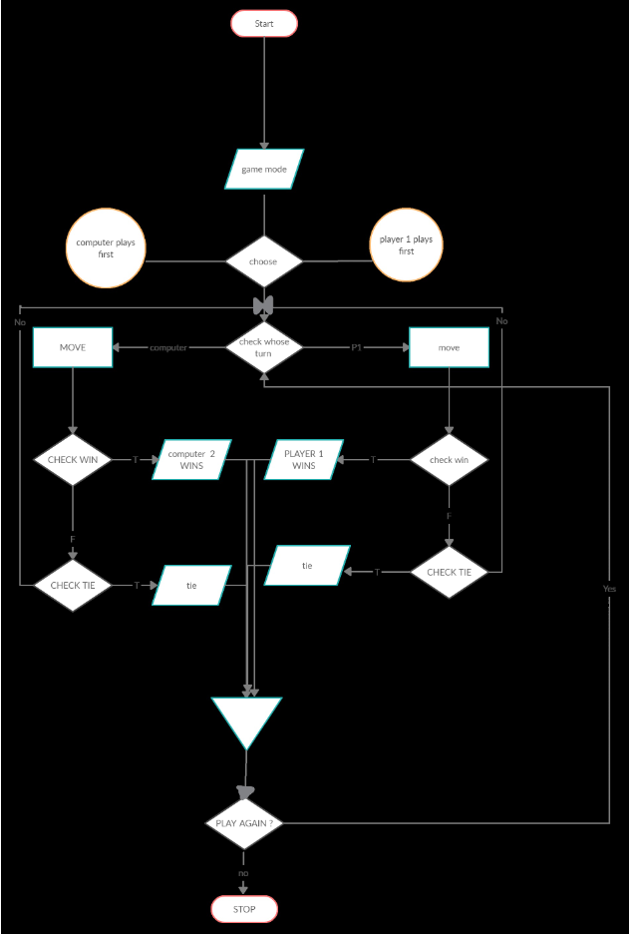
Flowchart

Slide 13
References
https://www.slideshare.net/UjjawalPoudel/mini-max-algorithm-proposal-document
https://www.geeksforgeeks.org/minimax-algorithm-in-game-theory-set-3-tic-tac-toe-ai-finding-optimal-move/
https://www.javatpoint.com/mini-max-algorithm-in-ai

Slide 14
We hope our end product is worth the wait!!☺
Thank You

